Slide 1
Python week 3
Canberra Chinese School Sem2

Slide 2
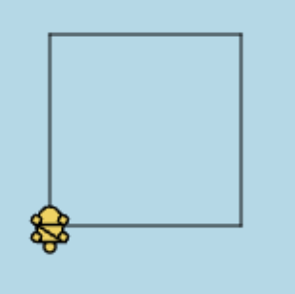

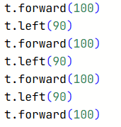
Turtle
Exercise:
How do we make a square?

Slide 3
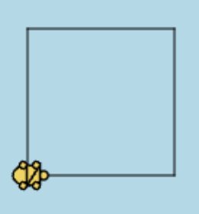

Turtle
Exercise:
How do we make a square?
We can shorten the code
a little bit

Slide 4
Turtle
Exercise:
How do we make a triangle?

Slide 5
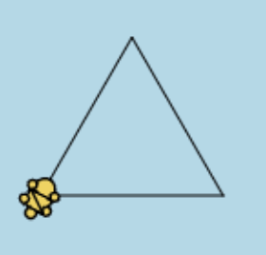
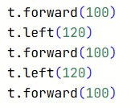
Turtle
Exercise:
How do we make a triangle?

Slide 6
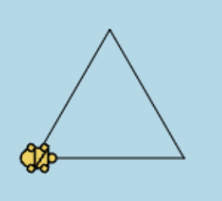

Turtle
Exercise:
How do we make a triangle?
This can be simplified into:

Slide 7
Turtle
Exercise:
How do we make a staircase?

Slide 8
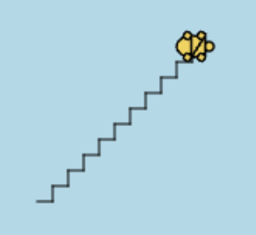
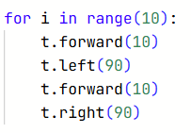
Turtle
Exercise:
How do we make a staircase?

Slide 9

Turtle
Challenge:
Using what we learned, how do we make a circle?
Hint: Explore and try out the things we learned and see if you can make a round shape. We learned: (x is just a number)

Slide 10
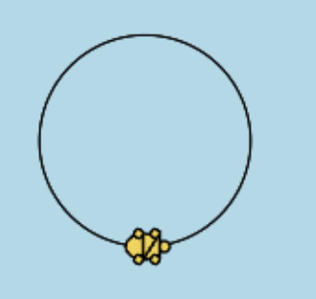

Turtle
Challenge:
Using what we learned, how do we make a circle?
There are other answers
too!

Slide 11
Turtle
Exercise:
Try out a bunch of things, explore what you can do with the canvas. Try to make some nice patterns, or a complete mess of randomness!

Slide 12


Turtle
For example, this makes a nice star pattern

Slide 13

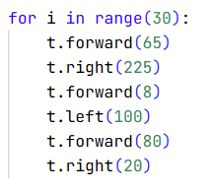
Turtle
Or you can just try something completely random.

Slide 14
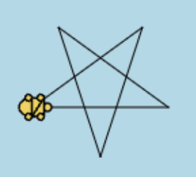
Turtle
The final exercise to challenge yourself:
Try to make a five-pointed star.

Slide 15
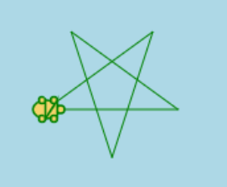

Turtle
We can of course change the colour of the star:

Slide 16

Turtle
The final exercise to challenge yourself:
Try to make a five-pointed star.

Slide 17

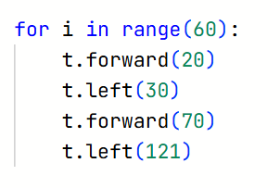
Turtle
Now let’s try something fun and random:

Slide 18

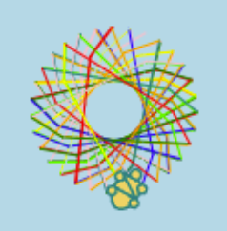
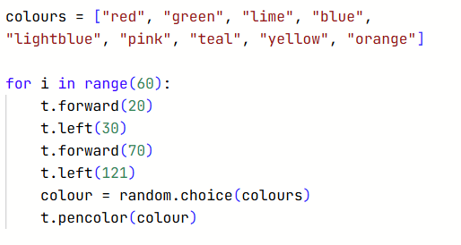
Turtle
Let’s make the colour random!

